Slide 1
Computer Science
New Graduate Student
Welcome & Orientation
Dr. George Markowsky Graduate Coordinator
(gradcoord@umsystem.edu)
Computer Science Department
(csdept@umsystem.edu)
August 14, 2019

Slide 2
Welcome
Faculty Introductions
Student Introductions

Slide 3
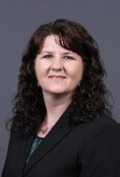
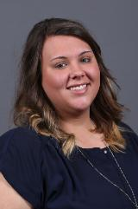
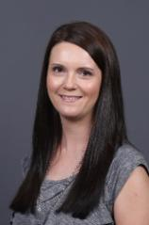
Office of Graduate Studies
Centralized graduate studies office for the entire Missouri S&T campus
Process all graduate forms for all graduate certificate, master’s & doctoral students
Interpret graduate catalog/rules; advise students on the graduate catalog/rules
Check formatting for theses/dissertations
Keep students on track to graduate
Graduate Studies Specialists
Students with the Students with the Students with the
last names A last names B-L last names M-Z
Sharon Matson Jade Sinnott Kathy Wagner
matsons@mst.edu sinnottj@mst.edu wagnerkc@mst.edu
Student Advising Hours
Monday - Friday
9:00 am -11:30 am - Appointment Only
2:00 pm - 4:00 pm - Open Advising
G8 Norwood Hall

Slide 4
Graduate Degree Programs
M.S. – study beyond the B.S.
In depth, advanced
Ph.D. – study beyond the M.S.
Original Research Contribution
MS vs. Ph.D.
All MS courses apply to your Ph.D.
Primary focus is research

Slide 5
Curriculum Issues M.S. Program – 31 Hours
With Thesis
6-9 hours research credit CS 6099
9 hours 6xxx level CS lecture courses
1 semester of Seminar course CS 6010 (one credit hour)
3 hour out-of-department course
CS 5200 - Algorithms
Without Thesis
15 hours 6xxx level CS lecture courses
1 semester of Seminar course CS 6010 (one credit hour)
3 hour out-of-department course
CS 5200– Algorithms

Slide 6
Research vs. Coursework Option
Thesis
Significant research work in area of interest
Research Group vs. Individual
Career Opportunities

Slide 7
Curriculum Issues
Ph.D. Program – 72 Hours
15 hours 6xxx level courses
3 hour out-of-department course
3 semesters of Seminar course CS 6010 (One credit hour per semester, three semesters)
CS 5200 – Algorithms
At least 24 hours of CS 6099 research
At least 24 hours of courses
Other courses prescribed by Ph.D. Committee

Slide 8
PhD Qualifier Part 1 – Broad Knowledge
Student selects five 5000/6000-level CS lecture courses
Mandatory course: CS 5200 – Algorithms (unless CS 5200 was waived by the GPPC)
At least two additional 5000-level courses
Courses taken as part of Missouri S&T undergraduate curriculum also count
Non-qualified courses
Seminar/paper reading courses as determined by the GPPC
Courses taught by non-CS faculty are not allowed (faculty with courtesy appointments in the CS department are counted as CS faculty for this purpose)
Passing Criterion
A minimum grade of B on each course
A minimum GPA of 3.5 averaged on the five selected courses, taken during or before the first three semesters of the student’s Ph.D. program
When a student makes below B on CS 5200, offer one more attempt to make B or higher on each exam in CS 5200 in the subsequent semester. If the student’s advisor teaches CS 5200, then the GPPC will provide and grade alternative comprehensive exams.
Out of the PhD program if the student fails the GPA requirement

Slide 9
PhD Qualifier Part 2 – Research Readiness
The student must declare a dissertation advisor
Dissertation advisor
Provide a list of 10-15 papers fundamental to the student’s future research
This list is customized to the student’s research interest
GPPC
Provide feedback to the advisor regarding the quality of the papers (note that this is merely meant to ensure a high standard, not to second guess the advisor in regard to appropriate papers)
Approval of the final list
Research Qualifier Exam Committee
At least 3 faculty members including:
Dissertation advisor
At least one faculty member from GPPC
At least one faculty member who has closely related research expertise
All members must be graduate faculty
Dissertation advisor forms the exam committee
GPPC approves the final selection of the exam committee members
Format
Written exam
Each committee member provides 2-3 questions based on the reading list
The questions need to be reviewed and agreed by the exam committee
Oral exam
A follow-up Q&A session where the committee members may ask any questions related to the selected papers and the written exam
Timeline
The number of attempts: 2
Deadline
Must be completed by the end of the second year
If the first attempt fails, the second attempt must wait for at least three months
Scheduling
The reading list is given to the student as early as possible
Within the deadline, a student can schedule the exam with the exam committee at any time
Once the questions are given to the student, the student has one week to complete the written exam
The oral exam will take place ideally within the first two weeks after the completion of the written exam

Slide 10
CS 5200
Graduate material – not similar to any undergraduate courses
Placement
CS 5200 – Informal Exam by Dr. George Markowsky
You must take this course to graduate!

Slide 11
Dept. of Computer Science, Missouri S&T Spring 2019 Seminar Series Seminars – usually on Monday, 10:00 – 10:50 in CS 209 You are expected to attend! Seminar Coordinator: Dr. Bruce McMillin ff@mst.edu 573-341-6435 http://cs.mst.edu/studentopportunities/seminars/

Slide 12
CS 6010 Guidelines
Computer Science students enrolled in this course must attend at least N-2 seminars, where N is the total number of seminars.
Enrolled students are required to write a report for each of the attended seminars.
Report format:
Length 1-2 pages typed, single or double space
Font Type: Times New Roman, size: 11-12
Contents:
Abstract
Introduction and background
Research contribution
Future work
Conclusion and your thoughts
Reports are due at most one week after the seminar
Reports are graded based on the format, structure, readability, summarization of the talk, and impact on CS.

Slide 13
Out-of-Department Courses
Any 5xxx/6xxx level course not used in the undergraduate curriculum may be taken that is out of the field of Computer Science study.
Cross-listed courses with CS, taught by a CS professor are considered CS – in department – courses
ECE courses may be taken as out-of-department if not taught by CS faculty.

Slide 14
Out-of-Department Course Suggestions
Math & Stat
Stat 5643– Probability And Statistics
Stat 5644– Mathematical Statistics
Math 5107– Combinatorics And Graph Theory
Math 5603– Methods of Applied Mathematics

Slide 15
IST – Information Science & Technology
Acceptable IST courses
5251Technological Innovation Management and Leadership (but not also EMGT 5100 nor EMGT 5111)
4257Network Economy
4261 Information Systems Project Management (but not also EMGT 361)
5168 Law & Ethics in E-Commerce (but not also CS 317)
5885 Human Computer Interaction
5886 Human-Computer Interaction Prototyping
5887 Human-Computer Interaction Evaluation
6887 Research Methods in Human-Computer Interaction
Other IST courses with Advisor and Graduate Advisor approval only.

Slide 16
Deficiencies
Courses that must be made up within the first 2 semesters
Listed on your admission acceptance letter
If you have deficiencies, you will have a worksheet. Take the worksheet to the faculty listed and they will give a placement test or you can enroll in an upper level equivalent course and score a “B” or better (see next slide) – Needs to have plan set up by September 1, 2019 or before your graduate forms can be processed.
Return completed sheet to department – CS 325
You must take care of this before you can Graduate!!!!!

Slide 17
Deficiency Course | Graduate Course (All courses have to be completed with a "B" or better
MATH
Calculus (Math/Stat 1205,1221,2222)
Linear Algebra (Math/Stat 3108)
Statistics (Math/Stat 3115) | Any STAT 5000 or higher
COMPUTER ENGINEERING
Introduction to Microcontrollers and Embedded System Design (CpE 3150) | CS 5803 Introduction to High Performance Computer Architecture
COMPUTER SCIENCE
Java or C++ (CS 1570) | CS 5405 JAVA GUI & Visualization
Data Structures (CS 1575) | CS 5201 Object-Oriented Numerical Modeling I
Discrete Math (CS 1200) | CS 5203 Mathematical Logic I
Software Engineering I (CS 3100) | CS 5101 Software Testing and Quality Assurance
Theory of CS (CS 2200)
File Structures (CS 2300) | CS 5300 Database Systems
Algorithms (CS 2500) | CS 5200 Analysis of Algorithms
Operating Systems (CS 3800) | CS 5800 Distributed Computing

Slide 18
Advising – If Not Already Done
Check out folder
Meet with faculty member about your program - today
Check-in folder in CS 325 (Folders need to be returned to office by 4:30pm today)
Get picture taken at the time you check in your folder
Go register in Parker Hall today
For every following semester, you will register with JOE’SS – you must be advised during advising week (announced by the registrar). Failure to make an appointment will result in a hold on your registration.

Slide 19
Graduate Form I - MS
Plan of Study – Form I which can be found at http://grad.mst.edu/currentstudents/forms/
Must be Typed, no handwritten forms accepted
Must be filed within 1st 6 weeks of 2nd semester which is February 28, 2020 if not turned in by due date a hold on registration will be placed until received and no CPT forms will be signed until completed
Signed by Advisor – Non-Thesis
Signed by Advisor & committee – Thesis

Slide 20
Program of Study, Form 1 & 1-A for instructions, see "Instructions" page |  |  |  |  |  |  |  |  |  | Expected graduation date
SUBMIT TYPED ORIGINAL. NO HANDWRITTEN FORMS.
 |  |  |  |  |  |  |  |  |  | Student ID
Name
Email |  |  |  |  |  |  |  |  |  | Phone
Degree |  |  | MS |  |  | ME |  | MBA |  | 2nd MS |  |  |  | Thesis |  |  |  | Non-thesis
 |  |  | On Campus |  |  |  |  | EEC |  | EOAC |  |  |  | Off-Campus
Program |  |  |  |  |  |  |  |  |  | Program Status: |  |  |  | New |  |  |  | Revised
Previous undergraduate & graduate college training:
Add (A) Delete (D) | Course Dept. & No. |  |  | Course Title |  |  |  |  |  |  |  | Sem & Year | Indicate Cr Hrs where appropriate
 |  |  |  |  |  |  |  |  |  |  |  |  | 200 level |  | Transfer |  | 300 level |  | 400 lec |  | 490/300/ 400/410
Change in Committee:
Reason for Change:
Signatures: |  |  |  |  |  |  |  |  |  |  |  | Total Credit Hours *
 |  |  |  |  |  |  |  |  |  |  |  | *Please see instructions for minimums
Candidate |  |  |  |  |  |  |  |  |  |  |  |  |  |  |  |  |  | Date:
Advisor |  |  |  |  |  |  |  |  |  |  |  |  |  |  |  |  |  | Date:
 |  | Type name |  |  |  |  |  |  | Signature
Committee Member |  |  |  |  |  |  |  |  |  |  |  |  |  |  |  |  |  | Date:
 |  | Type name |  |  |  |  |  |  | Signature
Committee Member |  |  |  |  |  |  |  |  |  |  |  |  |  |  |  |  |  | Date:
 |  | Type name |  |  |  |  |  |  | Signature
Dept. Chair or Designee |  |  |  |  |  |  |  |  |  |  |  |  |  |  |  |  |  | Date:
VPGS or Designee |  |  |  |  |  |  |  |  |  |  |  |  |  |  |  |  |  | Date:
Graduate Form I
Must be typed, no handwritten forms will be accepted by the Office of Graduate Studies!!!!

Slide 21
Graduate Form 5 - PhD
Appointment of Advisory Committee & Proposed Plan of Study – Form 5 which can be found at http://grad.mst.edu/currentstudents
Must be typed, no handwritten forms
Must be filed after passing the part 1 of the Qualifier and part 2 Research Readiness
Signed by Advisor and committee members
Hold on registration if not filed

Slide 22
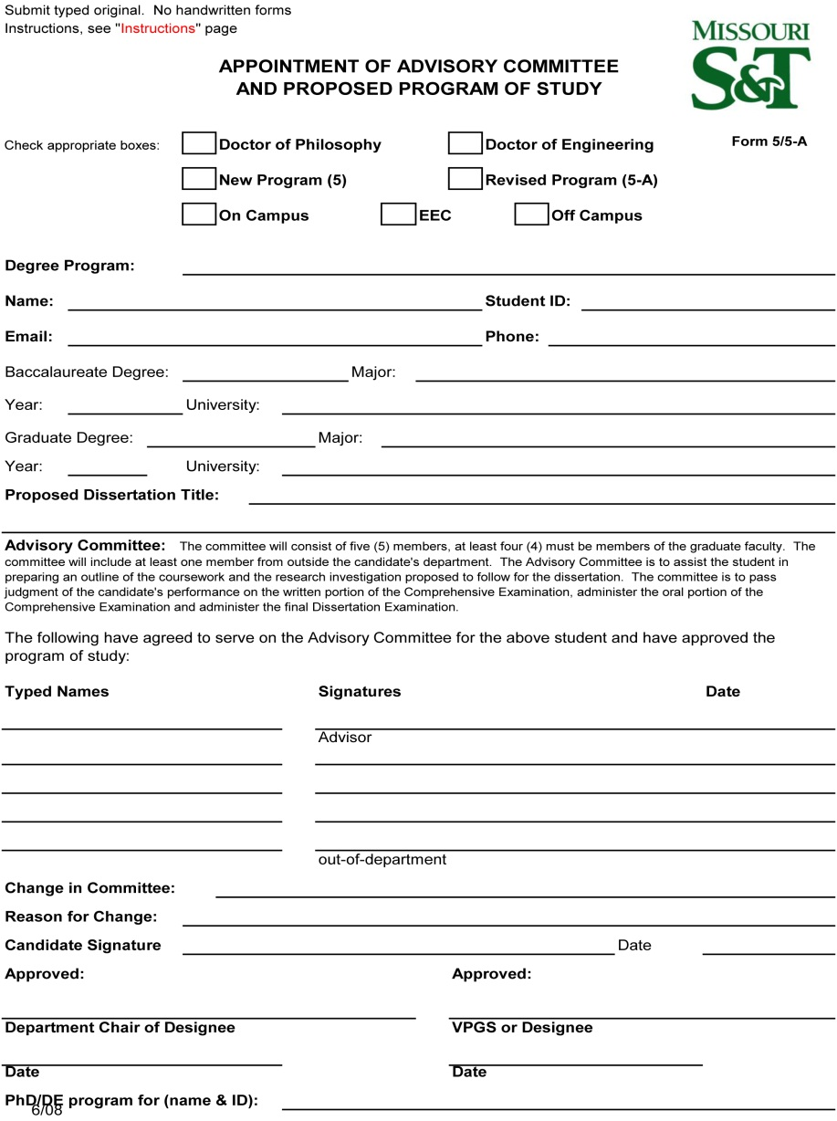
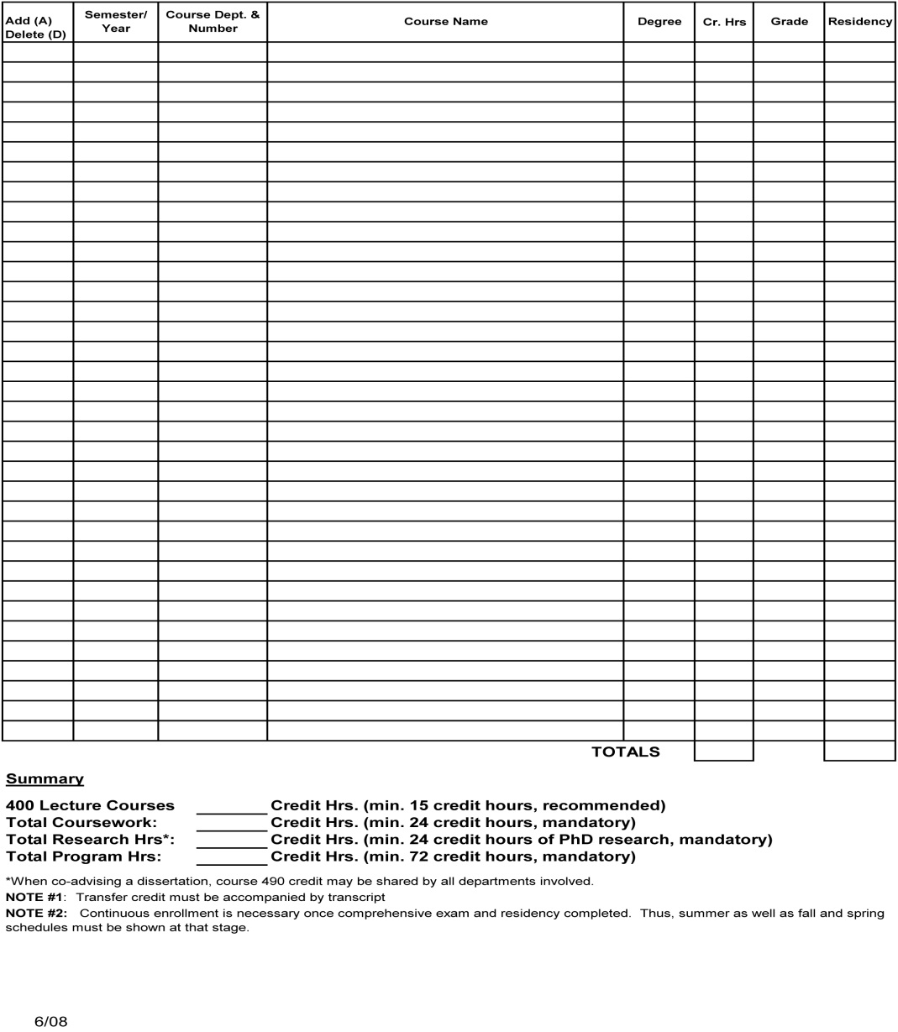
Graduate Form 5
Must be typed no handwritten forms will be accepted by the Office of Graduate Studies!!!!

Slide 23
Advising – Add/Drop
You must get your advisor signature for adding/dropping of courses.
Any unapproved course changes will result in being out-of-status (below minimum registration).
Secretaries cannot sign add/drop – don’t ask them to!

Slide 24
Assistantships
Applying for assistantships
Limited # of assistantships
Fill-out application cs.mst.edu/prospectivestudents/scholarships/ and turn it into CS 325 and attach any helpful information. These will be kept on file for a year

Slide 25
International Students
Sevis
In status
Minimum registration
Obey Form I
No changes without advisor’s permission!

Slide 26
Office Assignments & Labs
Offices only assigned to GTA’s and GRA’s
General computing laboratories: PC CLC’s, Cs213-Unix CLC, remote access

Slide 27
Academic Honesty
Be aware of campus academic honesty rules
Copying other’s work
Plagiarism
Consult Student Academic Regulations for more details; http://registrar.mst.edu/academicregs/index.html

Slide 28
Equal Employment/Educational Opportunity – CRR 600.020
Sex Discrimination, Sexual Harassment and Sexual Misconduct in Education.
Sex Discrimination
Sexual Harassment
Sexual Misconduct
Stalking on the Basis of Sex
Dating/Intimate Partner Violence
Sexual Exploitation
Consent to Sexual Activity
Incapacitated or Incapacitation

Slide 29
Equal Employment/Educational Opportunity – CRR 600.020
Title IX
If you feel you are a victim
If you see someone else is a victim.
*Do not hesitate to report*
All university employees are mandated reporters if the victim is any of a student, employee, volunteer, or visitor
There are no negative consequences for reporting an incident and retaliation is prohibited
We want a safe and secure learning environment for all

Slide 30
Keeping in Touch
E-mails (S&T account) – READ YOUR EMAIL
cs.mst.edu
Departmental Facebook
Missouri-ST-Computer-Science
Departmental Twitter
STCompScidept
Seminars – usually on Monday, 10:00 – 10:50 in CS 209. You are expected to attend!

Slide 31
Questions
Form 1?
Form 5?
Out of Department Courses?
Assistantships?
Advising?
CS 5200?
CS 6010

Slide 32
What to Do Next
Go see an advisor
Turn file in at CS 325
Then go to the Registrar’s Office & register for classes
Welcome to Missouri S&T Computer Science Department

